Slide 1












CJ
HW
A
DO
NOW
Inferring the Topic
25 min RAZ/Freckle
-
Task: Read your inference card s What is our topic?

Slide 2
B2BF2F
Move and find a partner.
Stand back to back.
When the music stops, turn and share.

Slide 3
Our New Topic is...

Slide 4
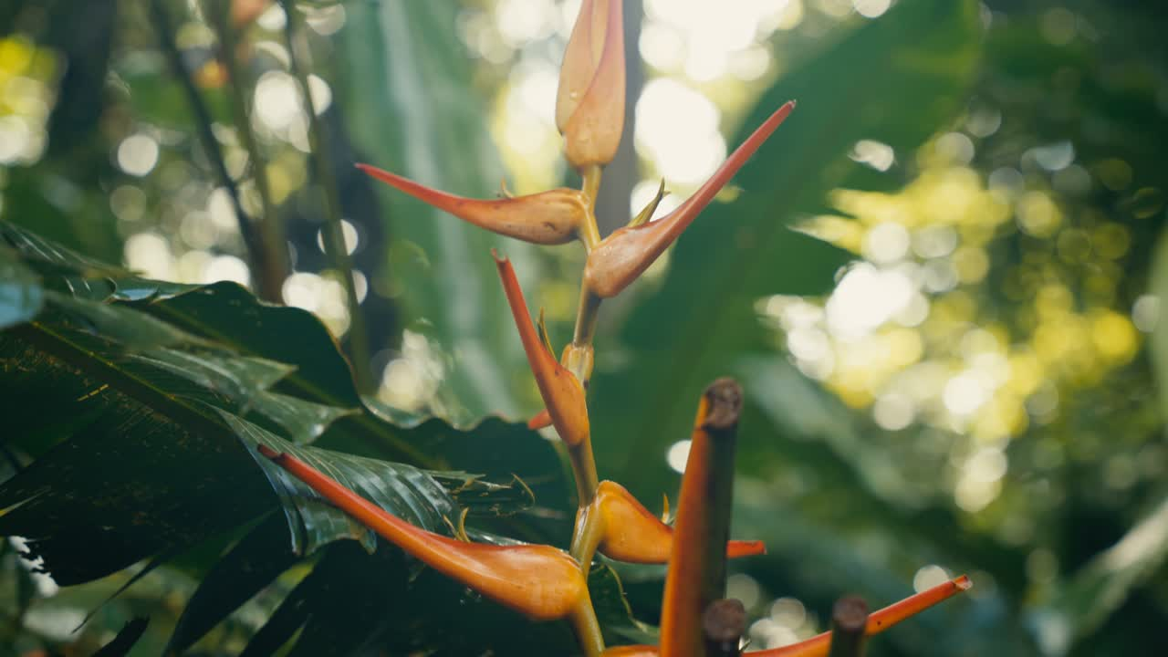
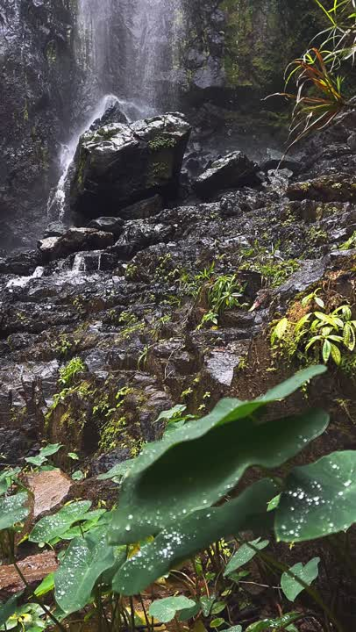
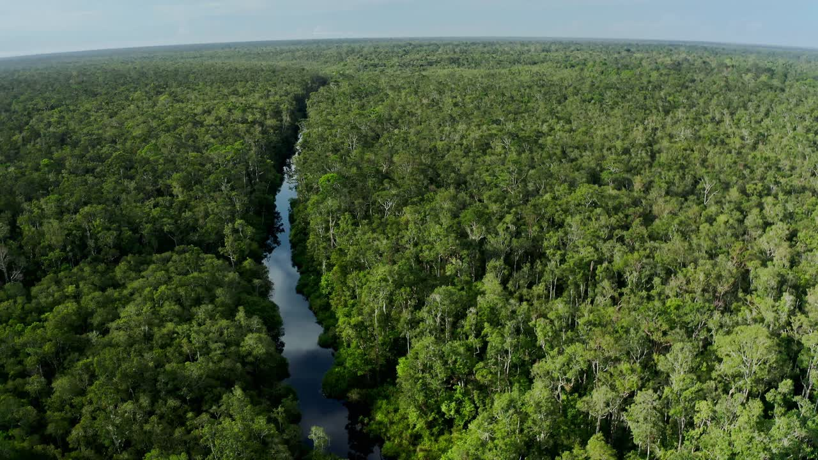

Slide 5

Think Pair Share
What do you know about the rainforest?

Slide 6
Think Pair Share
What do you know about the rainforest?

Slide 7
Guiding Questions
Why do people study and write about the rainforest?
How can we build background knowledge about a topic?

Slide 8
LEARNING OBJECTIVES
Language
Skill
I can infer the module
topic and support my
inferences with
details and examples
from images and text
I can find the gist
of a narrative
nonfiction text

Slide 9
Performance Task
Work with your partner to compile these narratives into a Rainforest Adventures ebook to be read on digital devices. Your ebook should include:
• Visually appealing cover page with title
• Contents page
• Author's note describing what the authors' choice of concrete and sensory language helps the reader understand
• Partner narrative with a list of sources
• Both individual narratives with a list of sources
• Carefully chosen images to support the content and make it visually appealing for the reader

Slide 10
Exploring the text
Flip through the book and read some areas that look interesting to you

Slide 11


LANGUAGE
LEARNING
OBJECTIVES
CFU
I can infer the module topic and support my
inferences with
details and examples
from images and text
SKILLS
I can find the gist
of a narrative
nonfiction text
THUMB-O-METER

Slide 12
PM
Subtitle

Slide 13
LEARNING OBJECTIVES
Language
Skill
I can infer the module
topic and support my
inferences with
details and examples
from images and text
I can find the gist
of a narrative
nonfiction text

Slide 14
KWL
Create a poster with things you KNOW about the rainforest.
After this:
Expanding Questions - Bus Station

Slide 15
Exploring the text
Flip through the book and read some areas that look interesting to you

Slide 16
TUESDAY
Subtitle

Slide 17
CJ
HW
A
DO
NOW
Describing Text
25 min RAZ/Freckle
-
Task: What do you notice about p9-12?

Slide 18
LEARNING OBJECTIVES
Language
Skill
I can describe the structure of a text. (RI.5.5)

Slide 19
Think Pair Share
What do you notice about p9-10?

Slide 20
Think Pair Share
What do you notice about p9-10?

Slide 21
Think Pair Share
What do you notice about p11-12?

Slide 22
Think Pair Share
What do you notice about p11-2?

Slide 23
Problem
→ Solution
These pages show a problem and a solution.
What can you find?

Slide 24
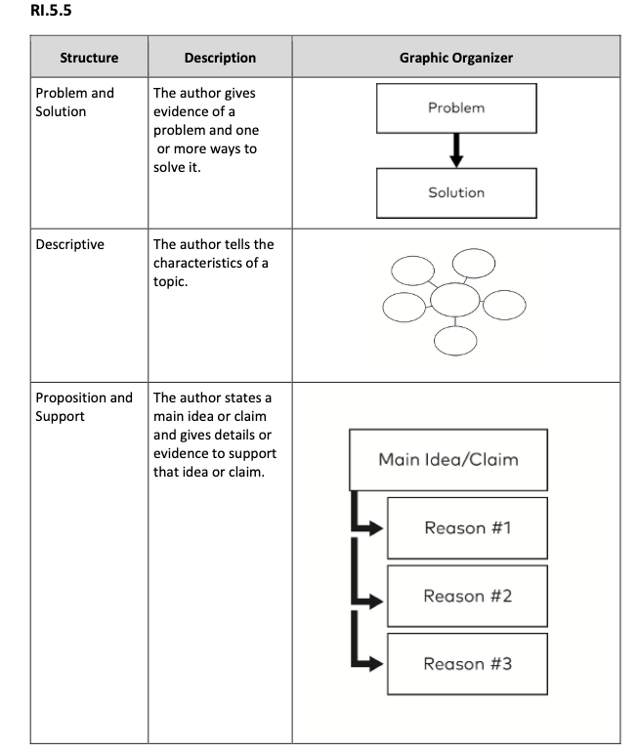
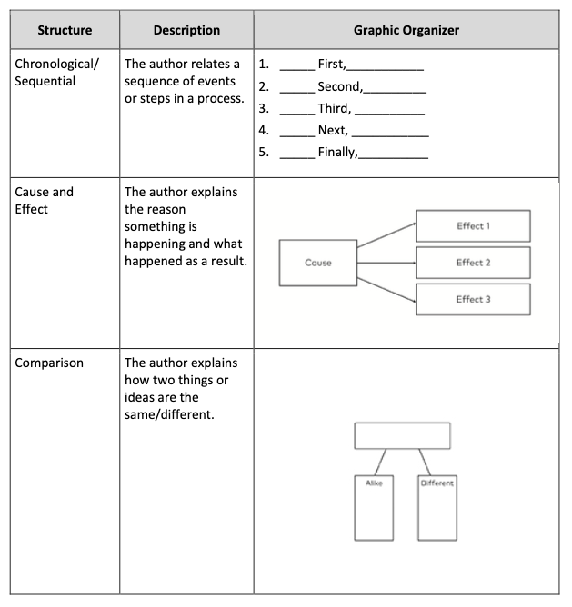
Text Structures

Slide 25
Descriptive & informational
We can learn a lot here and the author uses a lot of detail to give us a mental image

Slide 26
Guiding Questions
Why do people study and write about the rainforest?
How can we build background knowledge about a topic?

Slide 27
Stations
Describing Text Structures
P 9-10
P 11-12

Slide 28
Exploring the text
Flip through the book and read some areas that look interesting to you

Slide 29
LANGUAGE
LEARNING
OBJECTIVES
CFU
I can describe the structure of a text. (RI.5.5)
SKILLS
THUMB-O-METER

Slide 30
WEDNESDAY
Subtitle

Slide 31
CJ
HW
A
DO
NOW
GIST & SUMMARY
25 min RAZ/Freckle
-
Task: Write a gist for p9-10 on a sticky note

Slide 32
LEARNING OBJECTIVES
Language
Skill
I can make inferences about a text and cite evidence from the text to support my inferences. (RI.5.1,
I can analyze a summary and explain how it is effective. (RI.5.2)

Slide 33
Think Pair Share
Share and compare your gists

Slide 34
What does a good gist need?

Slide 35
What does a good gist need?
Group Work
P12-16, P17-22, P23-26

Slide 36
LANGUAGE
LEARNING
OBJECTIVES
CFU
I can make inferences about a text and cite evidence from the text to support my inferences. (RI.5.1,
SKILLS
I can analyze a summary and explain how it is effective. (RI.5.2)
THUMB-O-METER

Slide 37
THURSDAY
Subtitle

Slide 38
CJ
HW
A
DO
NOW
SUMMARY
25 min RAZ/Freckle
-
Close read “Why the rainforest is important”

Slide 39
LEARNING OBJECTIVES
Language
Skill
I can describe the structure of an informational text. (RI.5.5)
I can summarize an informational text. (RI.5.2, W.5.2)
I can analyze a summary and explain how it is effective. (RI.5.2)

Slide 40
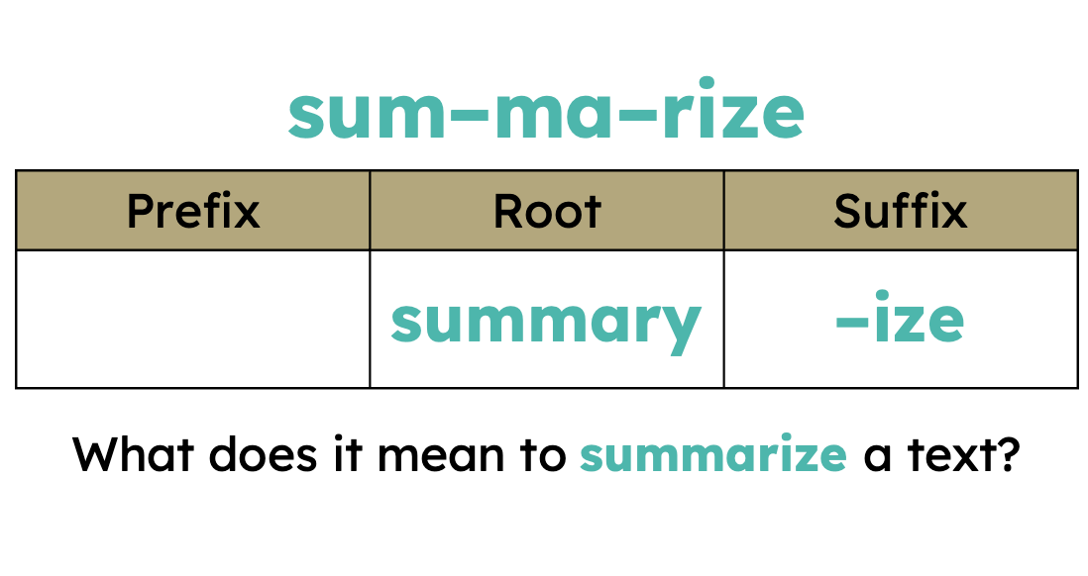

Slide 41
Analysing a summary
What is the text structure of “Why the rainforest is important”?
Why do you think so?

Slide 42
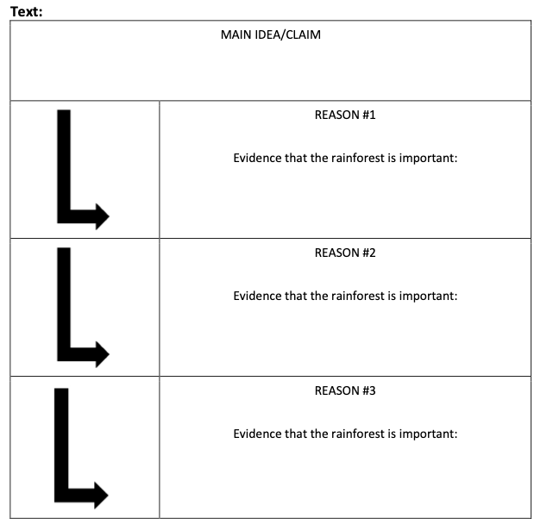
Analysing a summary
Proposition and support.
Think about the Painted Essay. What are we missing here?

Slide 43
Think Pair Share
What does a good summary need?

Slide 44
Think Pair Share
What does a good summary need?

Slide 45
Think Pair Share
What does a good summary need?

Slide 46
●Short – only a few sentences long
●Brief outline of what the text is about
●Introduces the text: title, pages, and author
●Clearly explains the theme or main idea
●Most important details to support the theme/main idea
●Complete sentences with subject and predicate

Slide 47
Analysing a summary
Look at your summary of p9-10.
Peer Talk - is it good? Why?
5 minutes
●Short – only a few sentences long
●Brief outline of what the text is about
●Introduces the text: title, pages, and author
●Clearly explains the theme or main idea
●Most important details to support the theme/main idea
●Complete sentences with subject and predicate

Slide 48
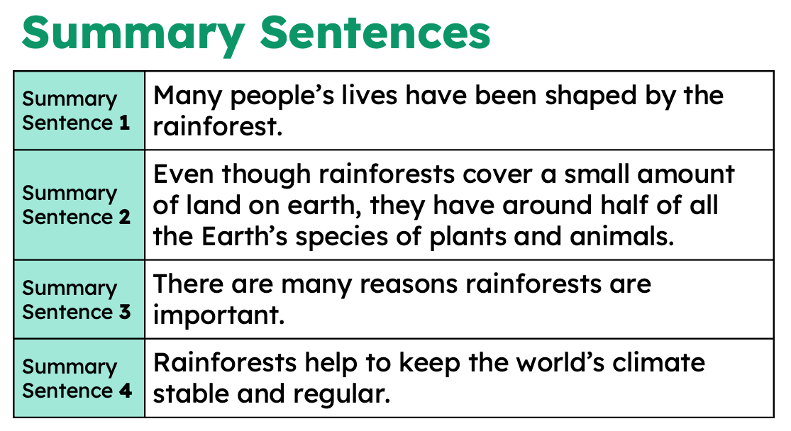

Slide 49
Now it’s your turn to write a summary for “Why the rainforest is important”. Work together in table groups and write one summary on essay paper.
●Short – only a few sentences long
●Brief outline of what the text is about
●Introduces the text: title, pages, and author
●Clearly explains the theme or main idea
●Most important details to support the theme/main idea
●Complete sentences with subject and predicate

Slide 50
LANGUAGE
LEARNING
OBJECTIVES
CFU
I can describe the structure of an informational text. (RI.5.5)
SKILLS
I can summarize an informational text. (RI.5.2, W.5.2)
THUMB-O-METER

Slide 51
FRIDAY
Subtitle

Slide 52
CJ
HW
A
DO
NOW
Comparing Text Structures
25 min RAZ/Freckle
-
Review “Why the rainforest is important” and p12

Slide 53
LEARNING OBJECTIVES
Language
Skill
I can make inferences about a text and cite evidence from the text to support my inferences, locating answers quickly and efficiently. (RI.5.7, W.5.7, W.5.8)
I can compare the overall structure of two texts about the rainforest. (RI.5.5)

Slide 54
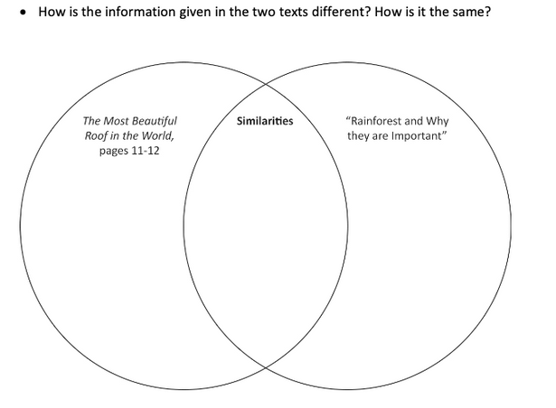
Comparing Text Structures
How is the information GIVEN in “Why the rainforest is important” and p12?
How is it different? How is it the same?
TPS - Group work.
Complete your workbook.

Slide 55
Think Pair Share
How is the information GIVEN in “Why the rainforest is important” and p12?
How is it different? How is it the same?

Slide 56
Think Pair Share
How is the information GIVEN in “Why the rainforest is important” and p12?
How is it different? How is it the same?

Slide 57
Think Pair Share
How is the information GIVEN in “Why the rainforest is important” and p12?
How is it different? How is it the same?

Slide 58
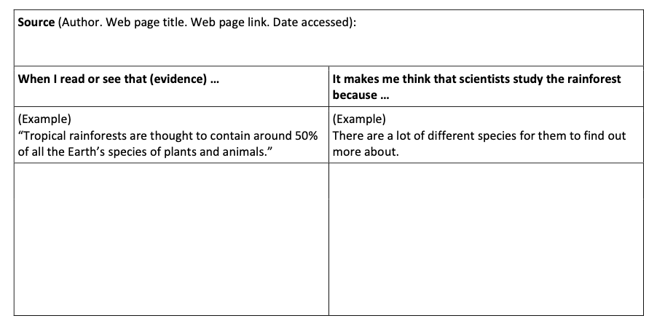
Question:
Why do scientists study the rainforest?
Find evidence and use it to infer an answer.

Slide 59
LANGUAGE
LEARNING
OBJECTIVES
CFU
I can make inferences about a text and cite evidence from the text to support my inferences, locating answers quickly and efficiently. (RI.5.7, W.5.7, W.5.8)
SKILLS
I can compare the overall structure of two texts about the rainforest. (RI.5.5)
THUMB-O-METER

